Slide 1


Bioinformatic approaches to incorporate epidemiological data
Brianna Lindsay, MPH PhD
@brlindsay88 @ClinEpiDB

Slide 2
The benefit of data sharing comes "not from providing access to data or depositing them somewhere, but from making it possible for others to find and reanalyze the data in a meaningful way"
Haug CJ. From patient to patient: sharing the data from clinical trials. N Engl J Med 374:2409–11 (2016).

Slide 3
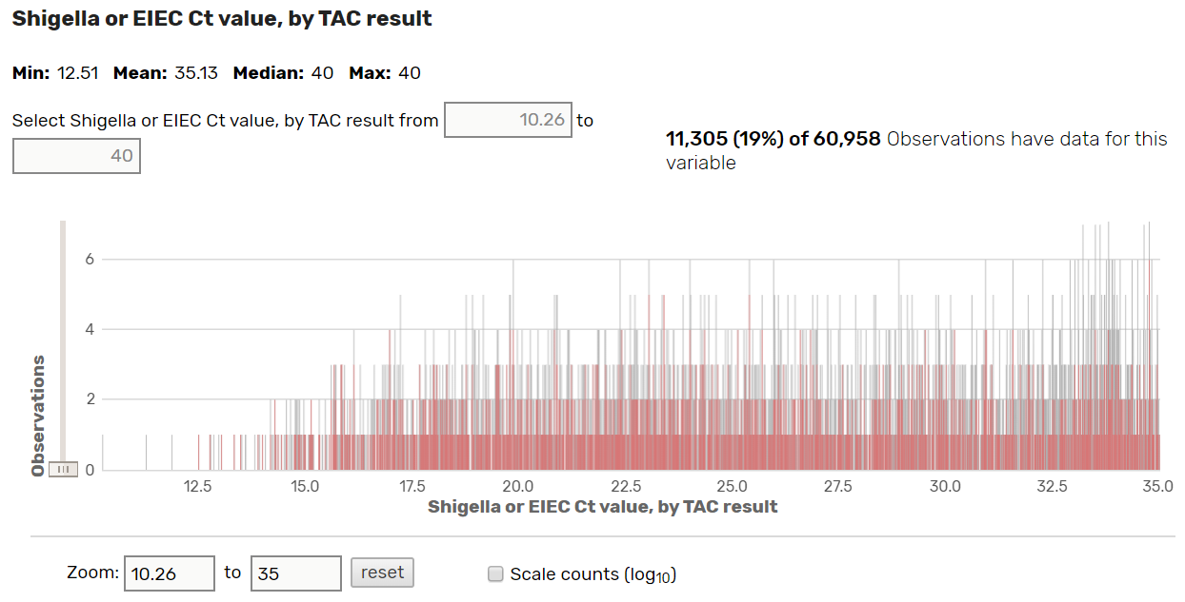
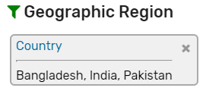
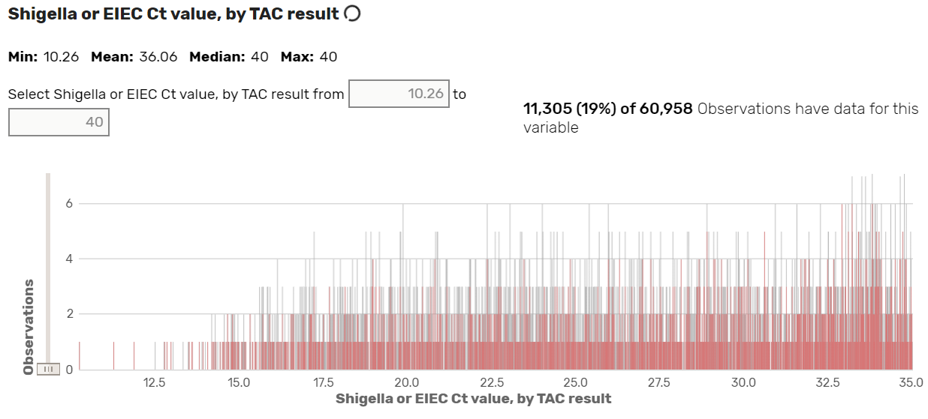
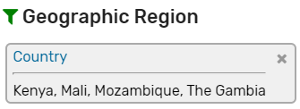
Distribution of qPCR data in African vs. Asian Sites in the GEMS Study

Slide 4
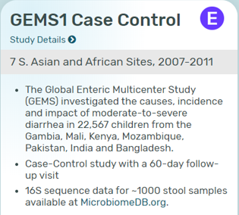
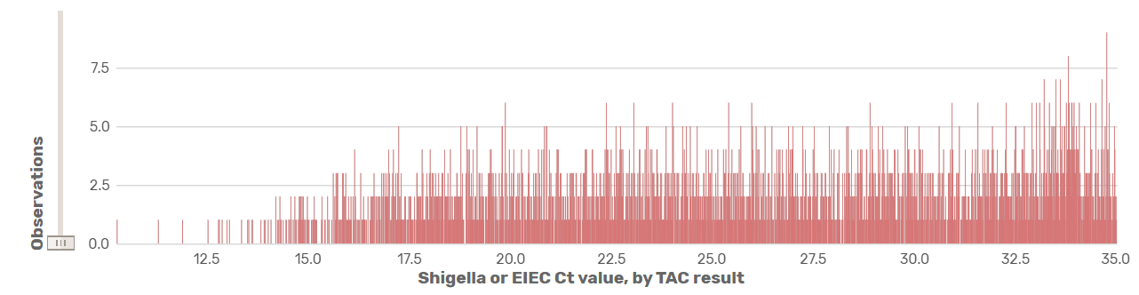
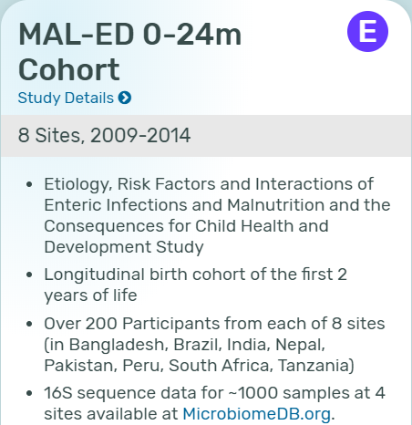
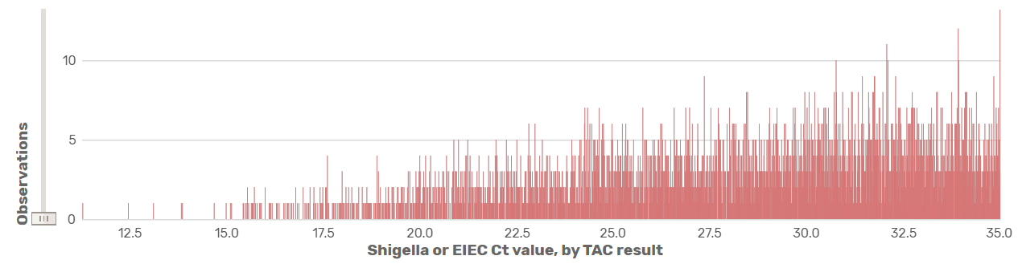
One step further: comparison between studies…

Slide 5

An Integrated Global Health Research Continuum
Large multi-site cohort with harmonized protocol

Slide 6
An Integrated Global Health Research Continuum
Large multi-site cohort with harmonized protocol
Site specific analyses

Slide 7
An Integrated Global Health Research Continuum
Large multi-site cohort with harmonized protocol
Site specific analyses
Nested case/control analysis

Slide 8
An Integrated Global Health Research Continuum
Large multi-site cohort with harmonized protocol
Site specific analyses
Nested case/control analysis
Measure biomarker expression

Slide 9
An Integrated Global Health Research Continuum
Large multi-site cohort with harmonized protocol
Site specific analyses
Nested case/control analysis
Measure biomarker expression
Pathogen sequencing

Slide 10
An Integrated Global Health Research Continuum
Large multi-site cohort with harmonized protocol
Decisions and methodology implemented at this level…..
Site specific analyses
Nested case/control analysis
Measure biomarker expression
Pathogen sequencing

Slide 11
An Integrated Global Health Research Continuum
Large multi-site cohort with harmonized protocol
Decisions and methodology implemented at this level…..
Site specific analyses
Nested case/control analysis
…..can impact interpretation of results on these levels!
Measure biomarker expression
Pathogen sequencing

Slide 12
FAIR Data Use
Biomedical research data should adhere to FAIR principles.
Findable
Accessible
Interoperable
Reusable
Must be easily retrievable via open systems
and effective and secure authentication and authorization procedures
Must be adequately described to a new user, have clear information about data-usage licenses, and have a traceable provenance
Must have unique identifiers, effectively labeling it within searchable resources
Should “use and speak the same language” via use of standardized vocabularies.
DataScience@NIH: Strategic Plan for Data Science. 2018 June
Wilkinson MD et al. The FAIR Guiding Principles for scientific data management and stewardship. Sci Data. 2016 Mar 15;3:160018.
Notes:
Scientific Data…
Clinical and public health data has been among the slowest to move towards open access
Legitimate ethical concerns
Greater use of research data
Generation of novel findings
Development of new research collaborations
Improved reliability through enabling independent evaluation
Transparency about the uses of public and private funding, increasing accountability

Slide 13
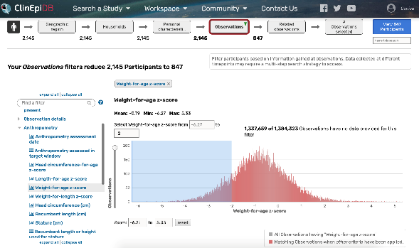
Processing streamlines integration and facilitates data sharing
Ontology
mapping
Organize standardized
data dictionary based
on semantic framework
GEMS
data
Render web display labels
supporting user queries
Standardized
data dictionary
Data dictionary
MAL-ED
data
Standardized
data dictionary
Data dictionary
ICEMR
data
Standardized
data dictionary
Data dictionary
ClinEpiDB
database
Load consistently-represented
data into central database

Slide 14
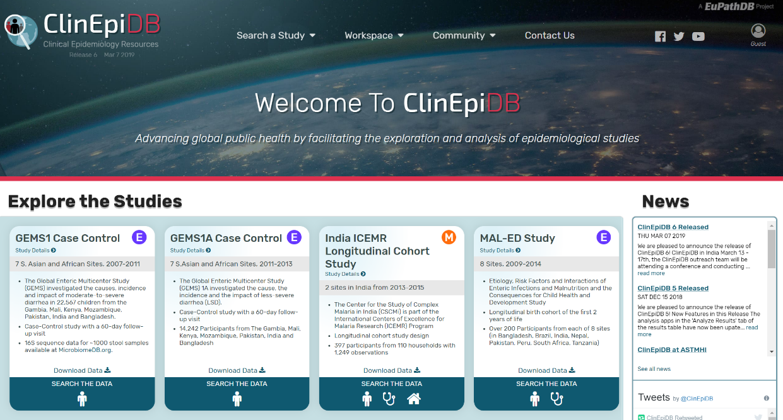
FAIR features of ClinEpiDB: data findability, accessibility, interoperability, reusability
Semantic harmonization enabling data integration
Search Wizard facilitating data exploration
Search Strategies supporting complex queries
Tabular display of individual record / result tables
Analysis Apps for data visualization
Data Download for further analysis
Configurable tiered system controlling data access

Slide 15
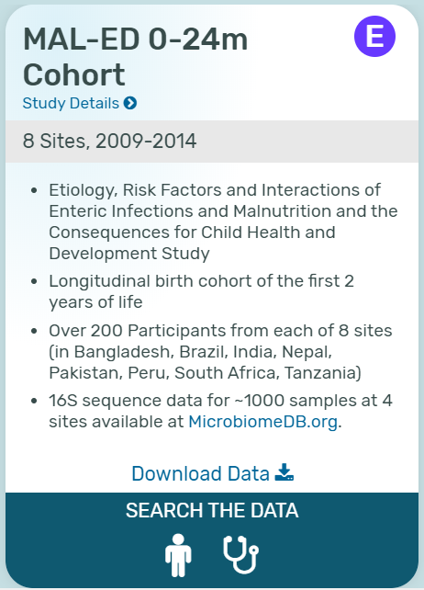
Each dataset is accessible through ‘cards’
Study title
Tag indicating
disease area (enteric)
Link to study details page
Location and time period
Brief description
and study design
Link to additional data
Link to download all data
Search by Participants
Search by Repeated Observations

Slide 16
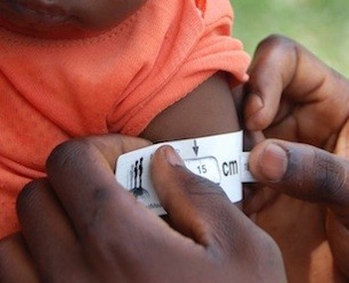
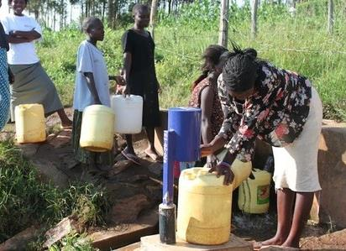
Integration of Epidemiologic and Genomic Data Types
Phenotypes and “metadata”
Anthropometrics
Molecular and conventional laboratory diagnostics
Socioeconomic data
Clinical signs and symptoms
*Photo Credit WASH-Benefits

Slide 17

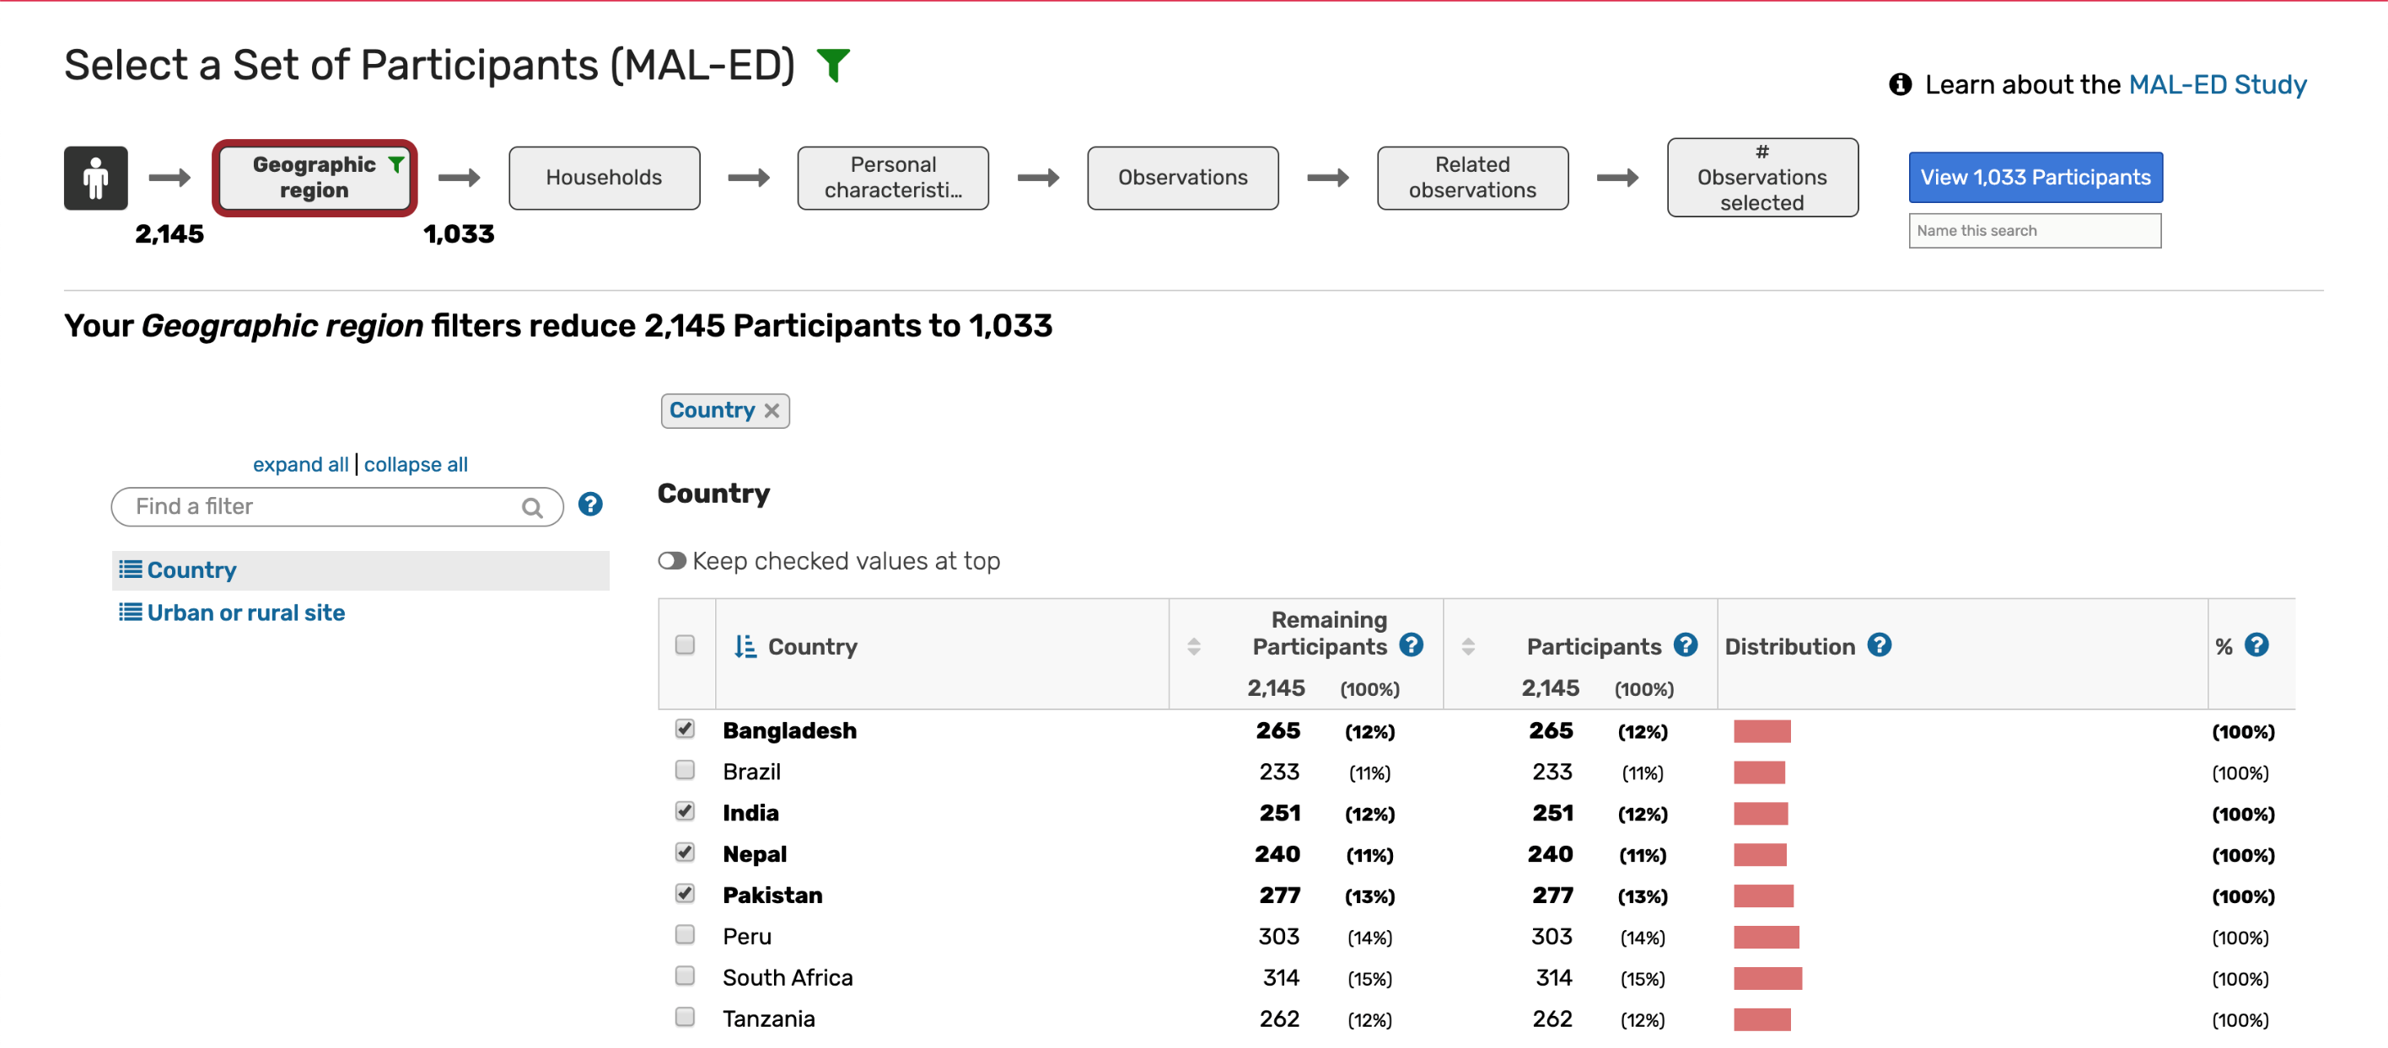


Slide 18
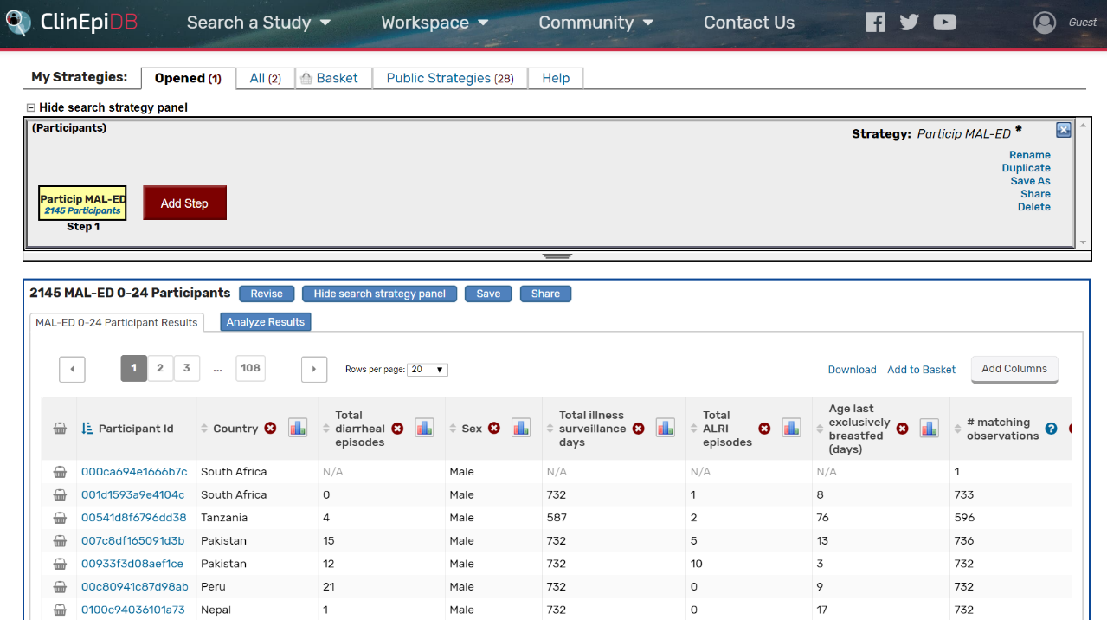
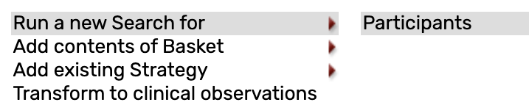

Slide 19
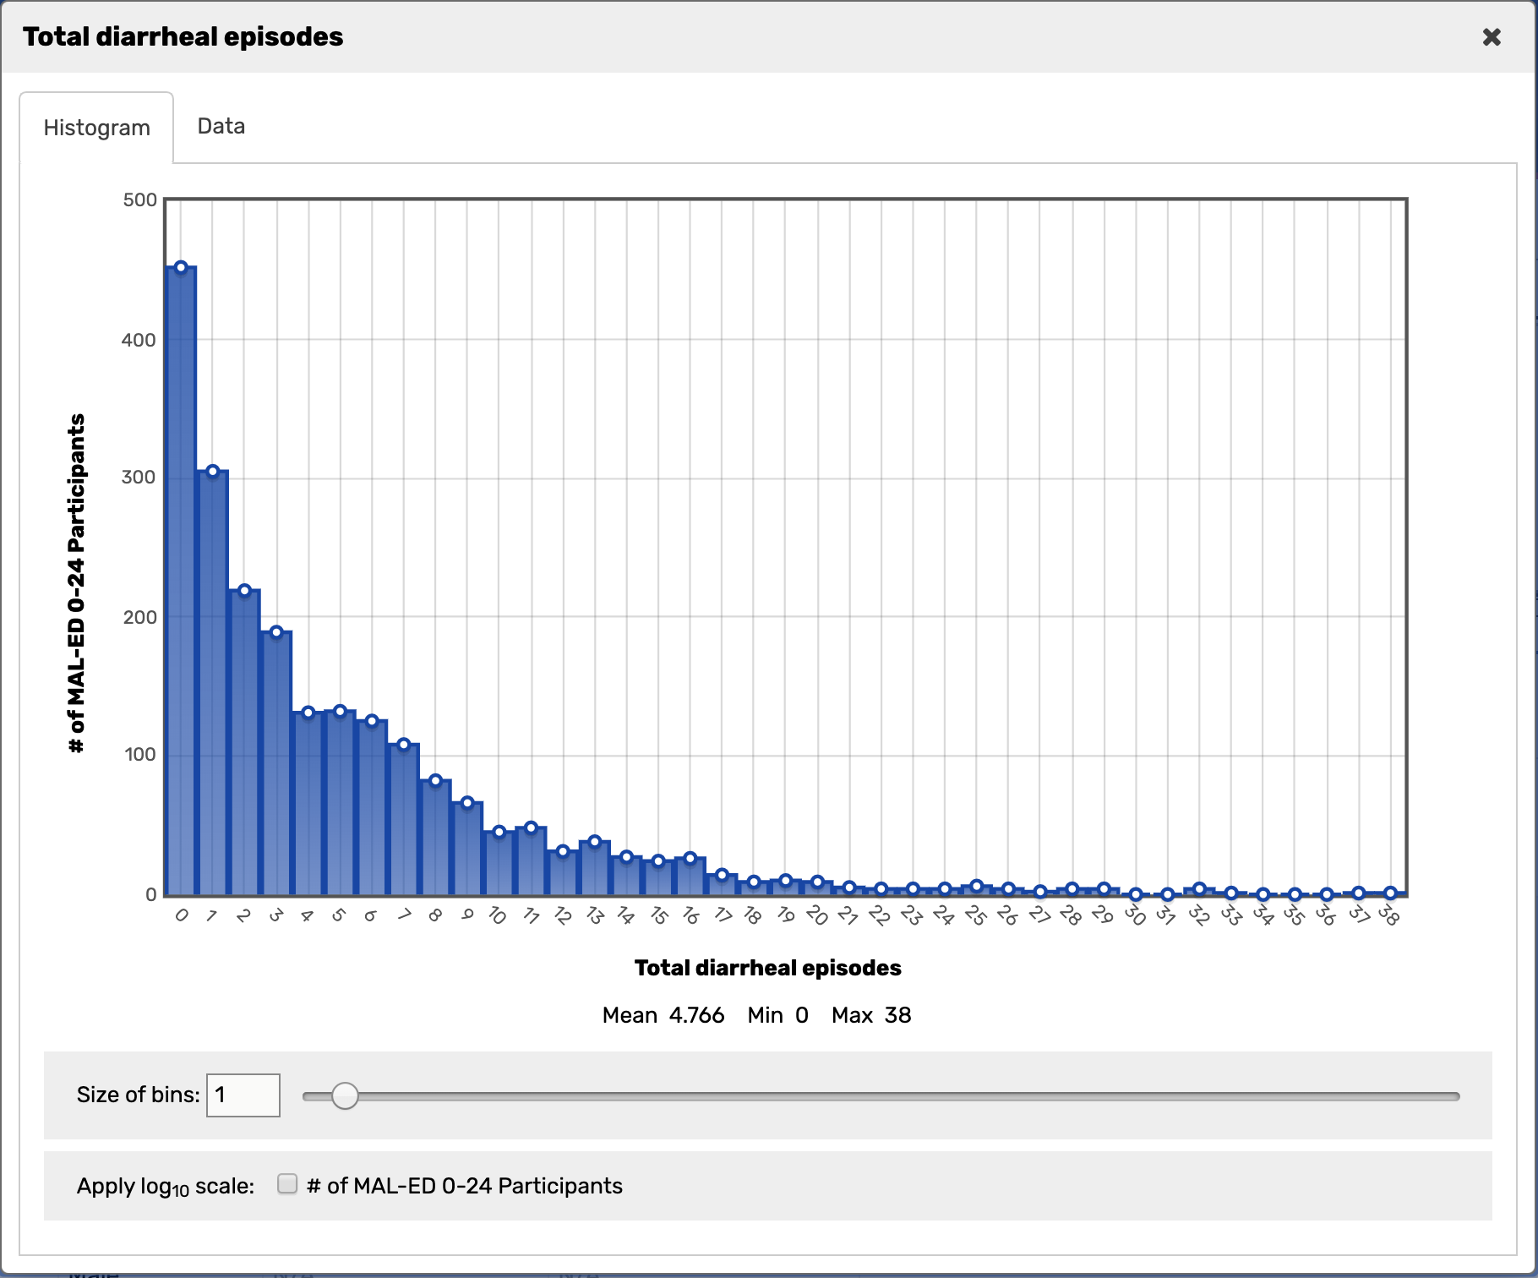

Slide 20
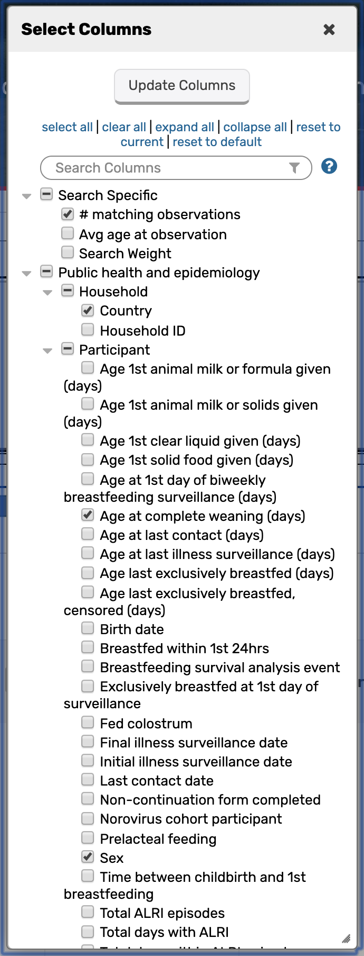

Slide 21
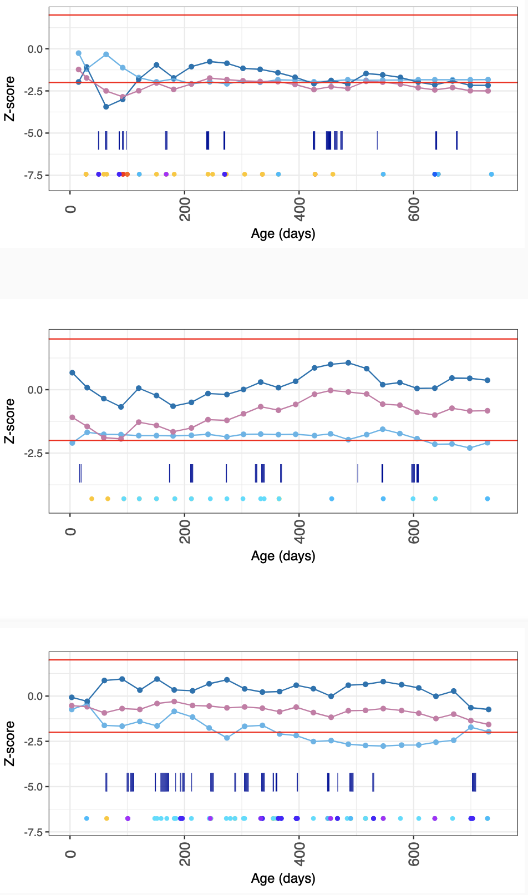
007c8df165091d3b
00933f3d08aef1ce
00c80941c87d98ab

Slide 22
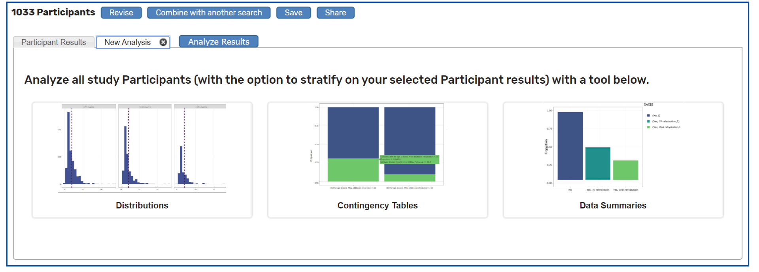
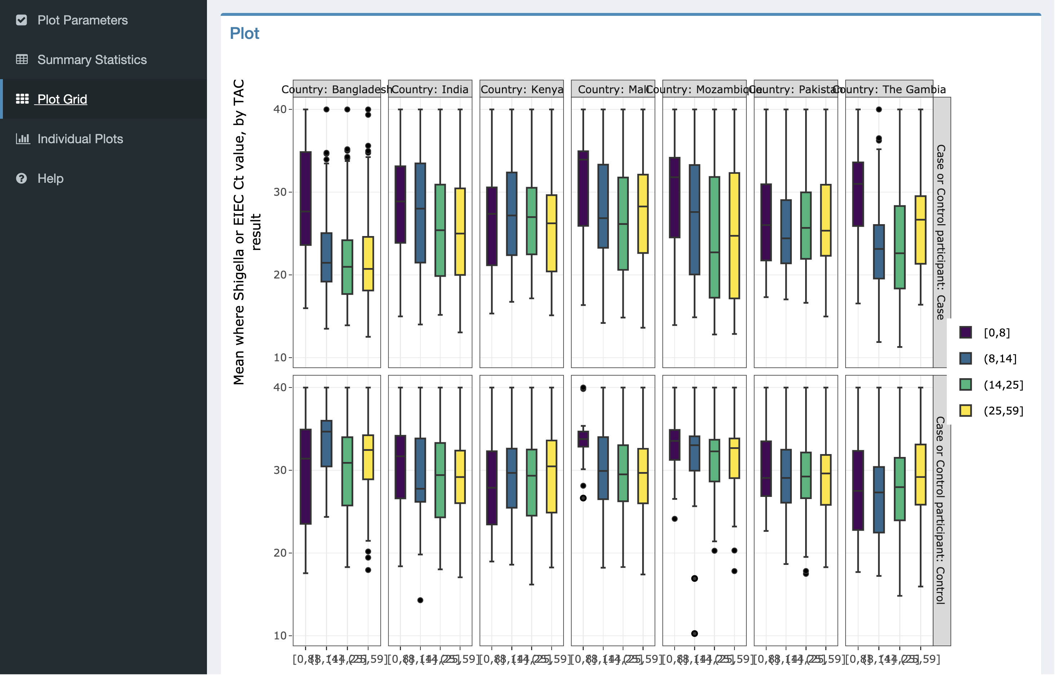
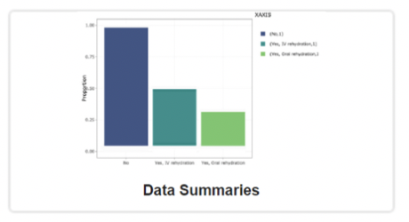
Analysis Apps for visualizing data
Example: Shigella in GEMS cases/controls,
stratified by country
Analyze all study Participants (with the option to stratify on your selected
Participant results) with a tool below.
Cases
Shigella
Controls

Slide 23
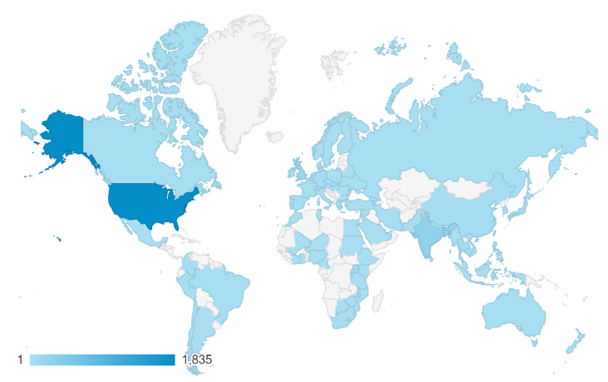

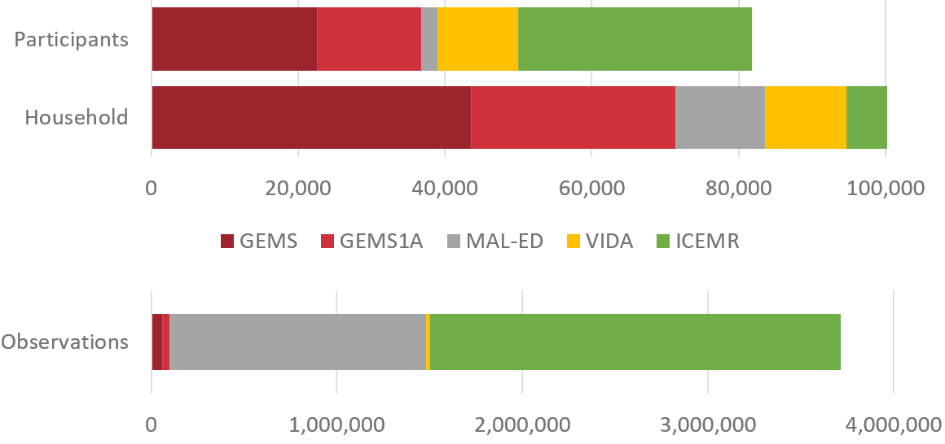


Facilitating epidemiologic data as an output
Expanding global influence
Notes:
*Note observations are not counted separately for separate variables but can be through of the number of ‘rows’ in a dataset; variables that were collected at the same collection time point or in a cross-sectional nature are considered part of the same observation

Slide 24
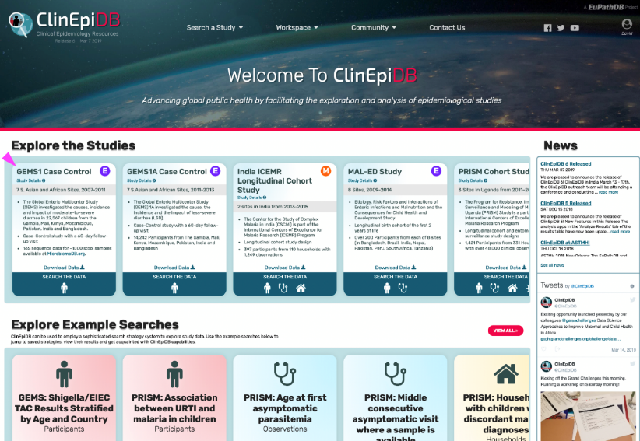
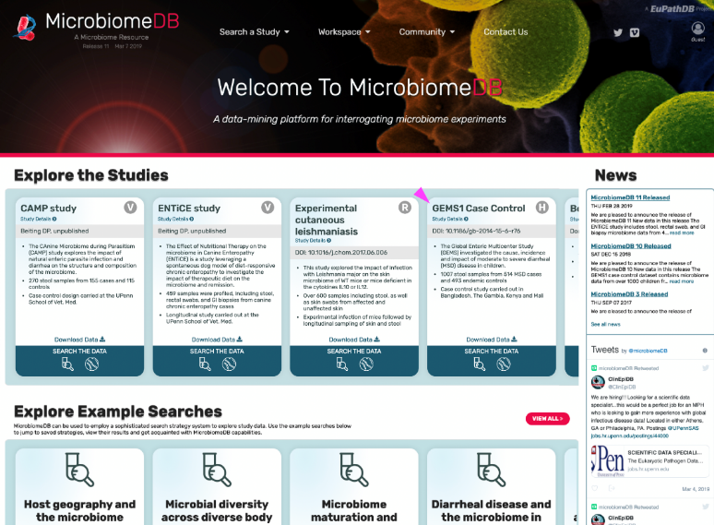
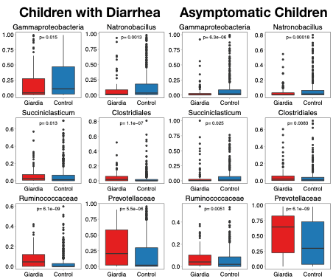
Integrating data from ClinEpiDB with data from MicrobiomeDB
GEMS Cases (moderate-severe diarrhea)
GEMS Controls (asymptomatic children)
Gammaproteobacteria Natrobacillus
Gammaproteobacteria Natrobacillus
Giardia + –
Giardia + –
Giardia + –
Giardia + –
Succiniclasticum Clostridiales
Succiniclasticum Clostridiales
ClinEpiDB.org
case vs control data
microbiology data
(Giardia ELISAs)
MicrobiomeDB.org
taxon abundance data
(1016 GEMS case and
control microbiomes)
Giardia + –
Giardia + –
Giardia + –
Giardia + –
Ruminococcacaea Prevotellacaea
Ruminococcacaea Prevotellacaea
Intuitive interfaces,
data analysis applica-
tions & visualizations
Breaking down silos:
through FAIR data access
reuse, and integration
Giardia + –
Giardia + –
Giardia + –
Giardia + –
Notes:
Case study in cross-silo data integration: Integrating clinical & epidemiological information from ClinEpiDB.org with microbiome data from MicrobiomeDB.org. Following up on observations from the GEMS study that Giardia infection is inversely correlated with moderate-to-severe diarrhea, throughout the world (slide 1), ClinEpiDB users might be prompted to ask whether the gut microbiome provides any possible insights into the basis for this surprising finding. Taxon abundance information was extracted from GEMS microbiome data freely available through MicrobiomeDB (courtesy of the study investigators), and integrated with GEMS diarrheal status, case vs control information, and other clinical metadata for the same patients in ClinEpiDB (also provided courtesy of GEMS investigators). Results: Giardia infection is associated with a significant reduction in Gamma-proteobacteria (slide 2), including many known pathogens (E. coli, Shigella, Salmonella, etc): there are far more gamma-proteobacteria in diarrhea cases than controls (as expected), but far fewer in Giardia+ samples than Giardia– samples (in both cases and controls). This analysis also reveals significant enrichment of Prevotellaceae in Giardia-infected children, regardless of their diarrheal status. Note that on the live site, users can dive deeper, dynamically exploring taxon distribution at the genus or species level, examining associations with Shigella or rotavirus infection, etc, suggesting testable hypotheses that might be used inform future trial design about the relationship between Giardia and bacterial taxa associated with enteric disease … with important implications for appropriate antibiotic or probiotic treatment. Such analyses are readily accessible to any interested party worldwide, without specialized informatics or statistical training, or restrictive and time-consuming data-access agreements.

Slide 25
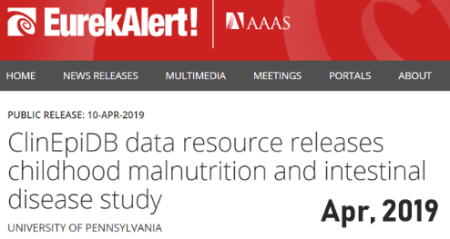


Continued engagement and future directions…
2018
2020
2017
2019
2021
GEMS

Slide 26
Continued engagement and future directions…
DIY Workspaces
Mapping
2018
2020
2017
2019
2021
2020
MORE DATA!!
VIDA, PERCH, WASH-Benefits, PROVIDE, SHINE, ANISA, AMANHI,
Better Birth, JiVitA
Continued ontological
development
GEMS

Slide 27
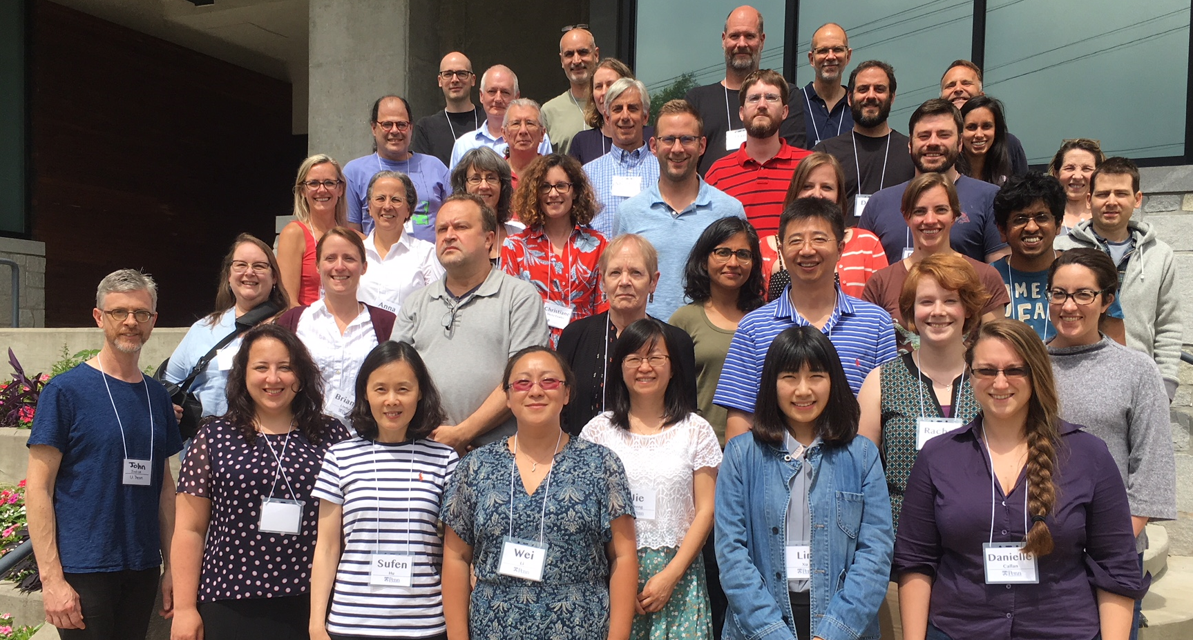



Thank you!
Clinical Epidemiology Resources

Slide 28
